Slide 1
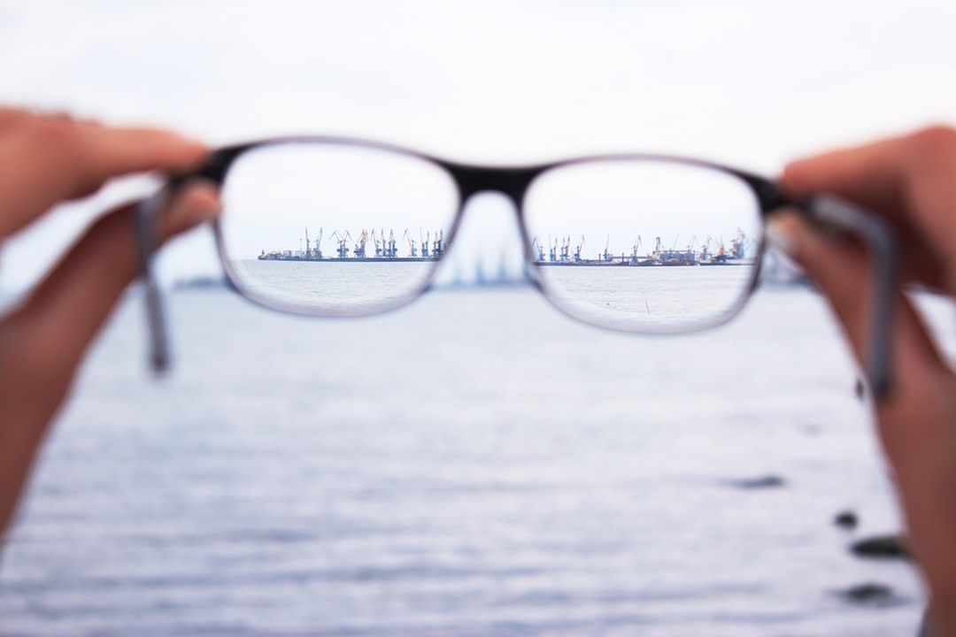
Attention Mechanism
Samira Zare
Group Meeting, March 31, 2020

Slide 2
Outline
Attention Idea
Attention Mechanisms
Attention Categories
Improvements

Slide 3
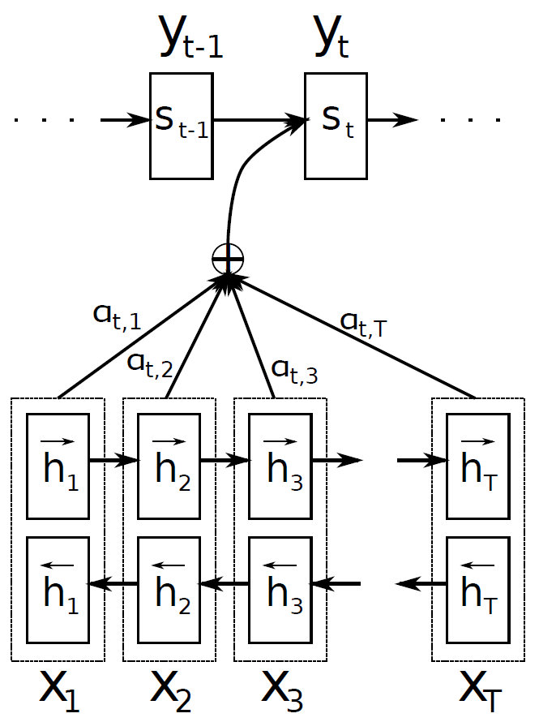
Attention: Born for Translation
Neural Machine Translation by
Jointly Learning to Align and
Translate (Bahdanau et al., 2015)

Slide 4
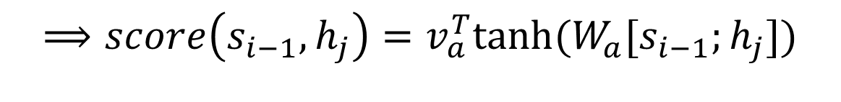

Bahdanau Attention
$$c_{i}=\sum_{j=1}^{T_{x}}{α_{ij}h_{j}}$$
$$α_{ij}=\frac{exp⁡(e_{ij})}{\sum_{k=1}^{T_{x}}{exp⁡(e_{ik})}}$$
$e_{ij}=a\left(s_{i−1},h_{j}\right)$
$$⟹score\left(s_{i−1},h_{j}\right)=v_{a}^{T}tanh⁡(W_{a}[s_{i−1};h_{j}])$$

Slide 5
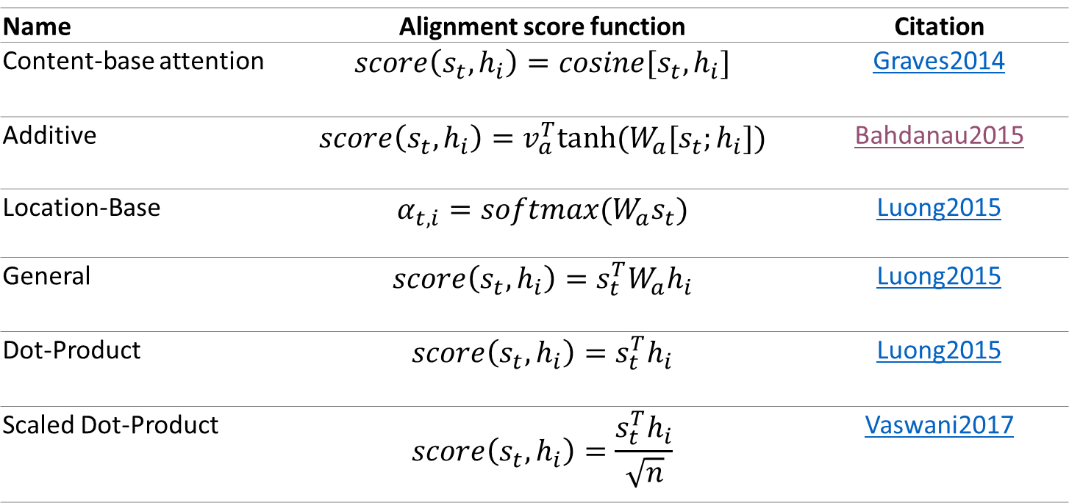
Attention Mechanisms
Name | Alignment score function | Citation
Content-base attention | $$score\left(s_{t},h_{i}\right)=cosine[s_{t},h_{i}]$$ | Graves2014
Additive | $$score\left(s_{t},h_{i}\right)=v_{a}^{T}tanh⁡(W_{a}[s_{t};h_{i}])$$ | Bahdanau2015
Location-Base | $$α_{t,i}=softmax(W_{a}s_{t})$$ | Luong2015
General | $$score\left(s_{t},h_{i}\right)=s_{t}^{T}W_{a}h_{i}$$ | Luong2015
Dot-Product | $$score\left(s_{t},h_{i}\right)=s_{t}^{T}h_{i}$$ | Luong2015
Scaled Dot-Product | $$score\left(s_{t},h_{i}\right)=\frac{s_{t}^{T}h_{i}}{\sqrt{n}}$$ | Vaswani2017

Slide 6
Categories of Attention Mechanisms
Name | Definition | Citation
Self-Attention | Relating different positions of the same input sequence. Theoretically the self-attention can adopt any score functions above, but just replace the target sequence with the same input sequence. | Cheng2016
Soft/Hard | Attending to the entire/part of input state space. | Xu2015
Global/Local | Attending to the entire/part of input state space. | Luong2015

Slide 7
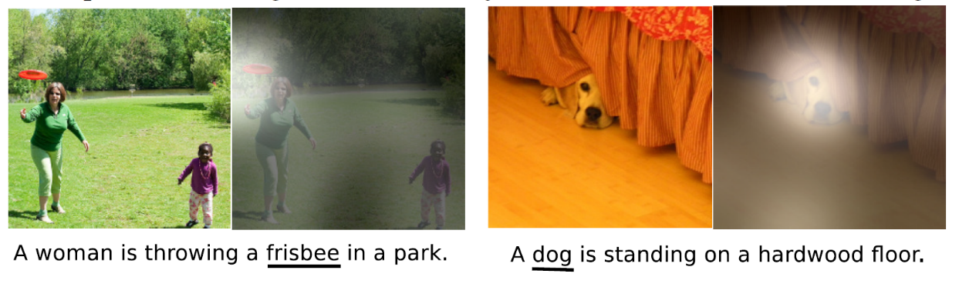
Soft Attention vs Hard Attention
Show, Attend and Tell: Neural Image Caption Generation with Visual Attention (Xu et al., 2015)

Slide 8
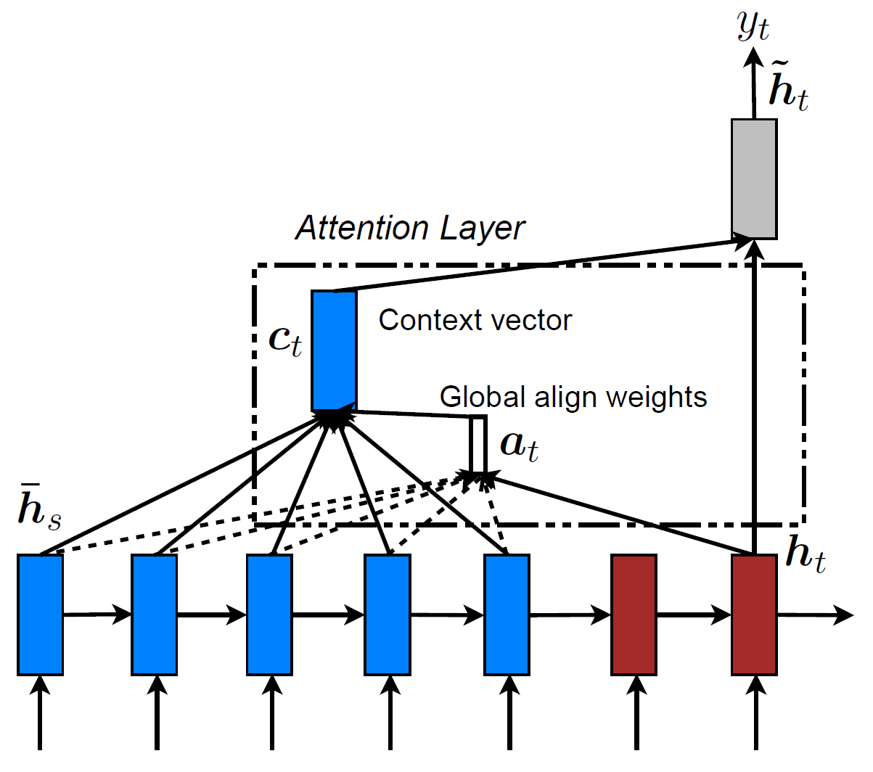
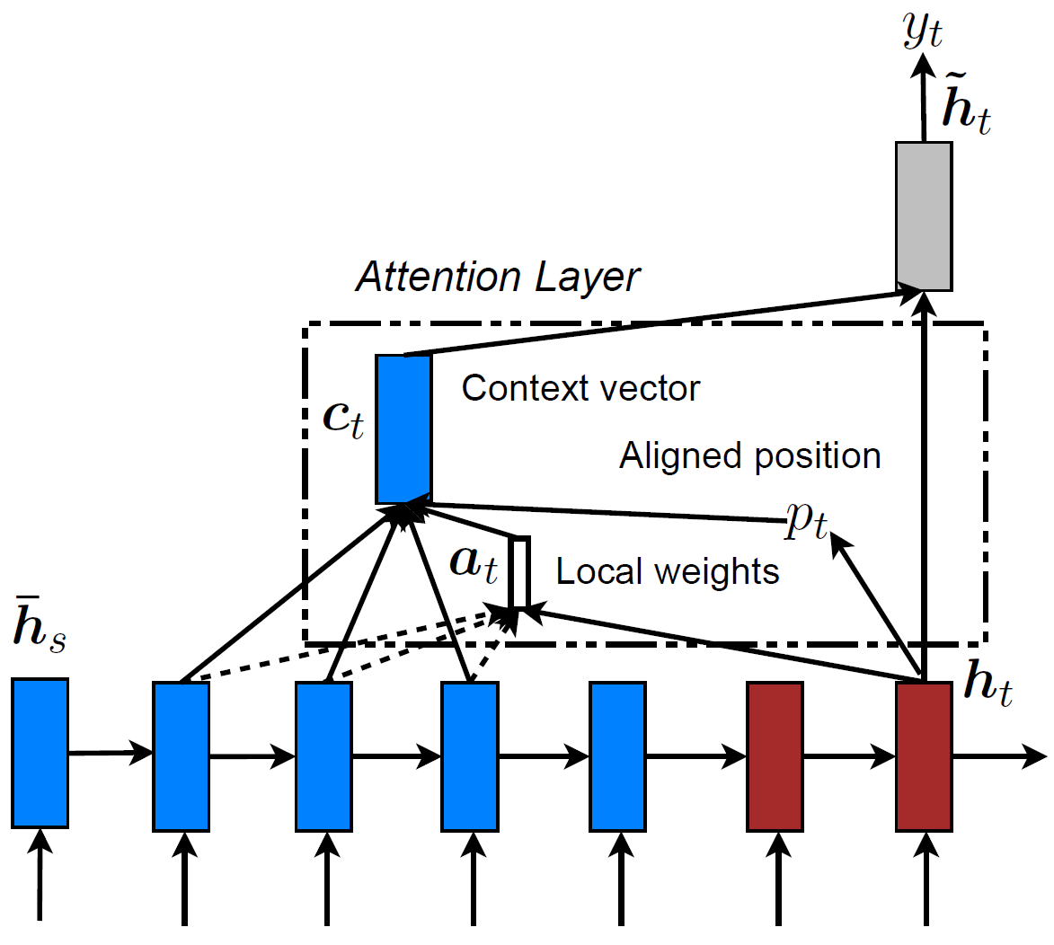
Global Attention vs Local Attention
Effective Approaches to Attention-based Neural Machine Translation (Luong et al. 2015)
Global Attention Local Attention

Slide 9

Local Attention
Window: $\left[p_{t}−D,p_{t}+D\right]$
Monotonic alignment (local-m):
$$p_{t}=t$$
Predictive alignment (local-p):
$$p_{t}=S.sigmoid(v_{p}^{T}tanh⁡(W_{p}h_{t}))$$

Slide 10
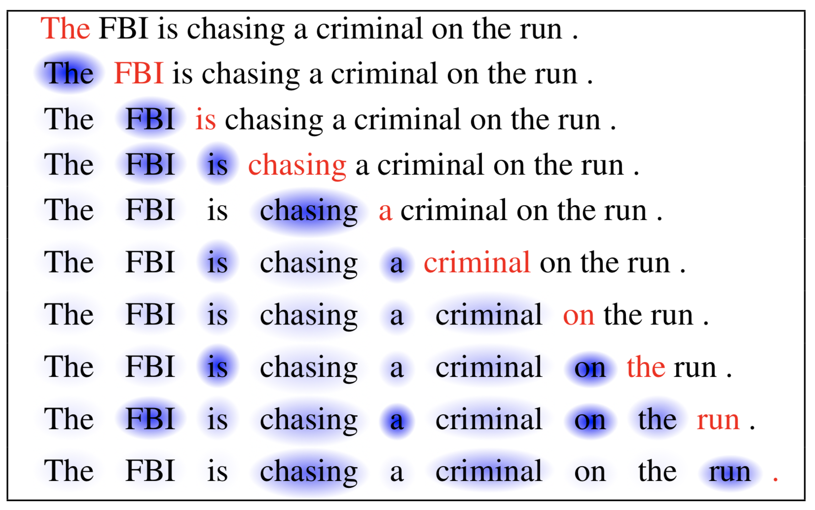
Self-Attention
Long Short-Term Memory-Networks for Machine Reading (Cheng at al., 2016)

Slide 11
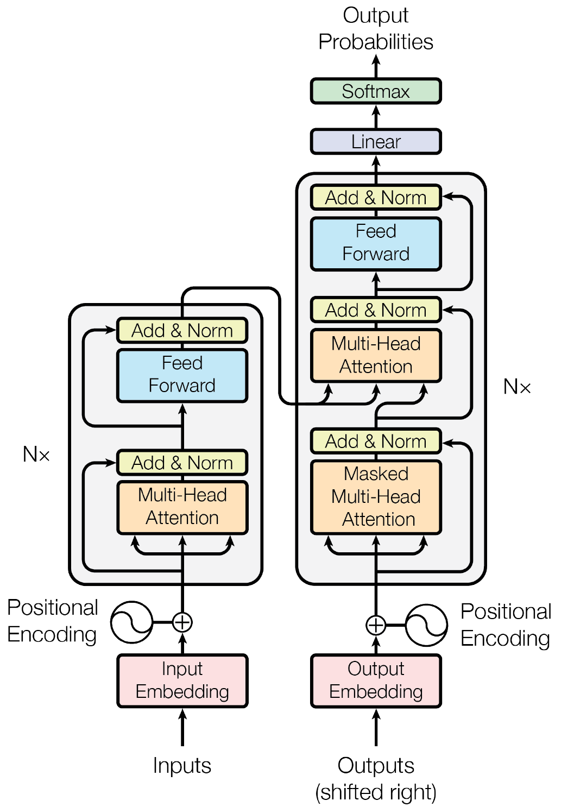
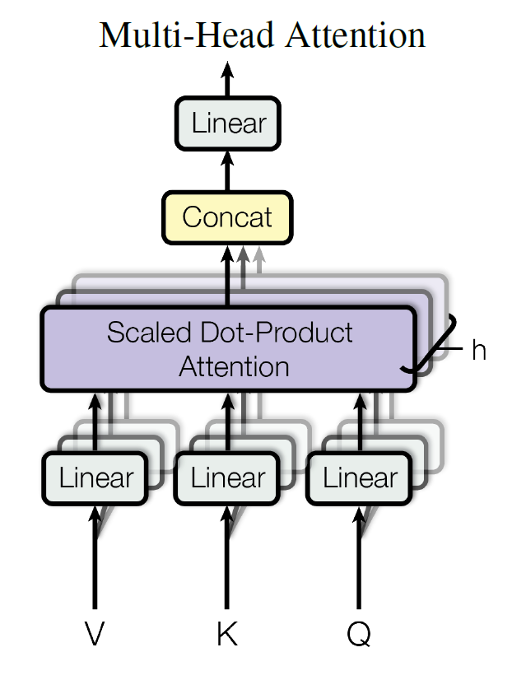
Attention Is All You Need
Transformers: built based on self-attention

Slide 12
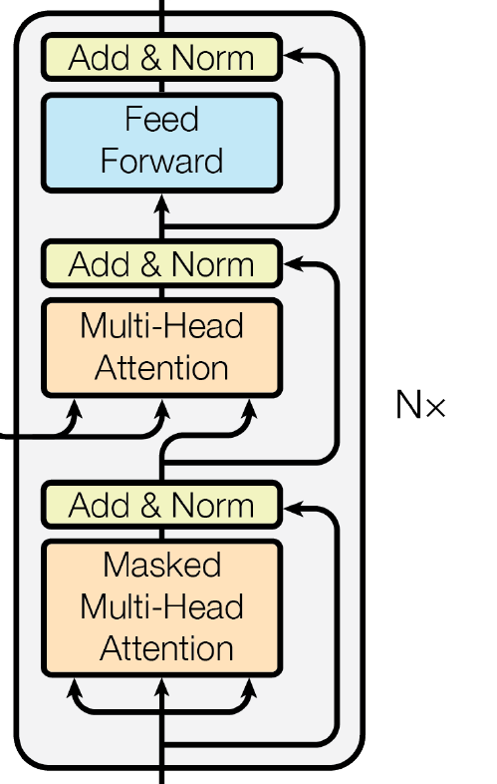
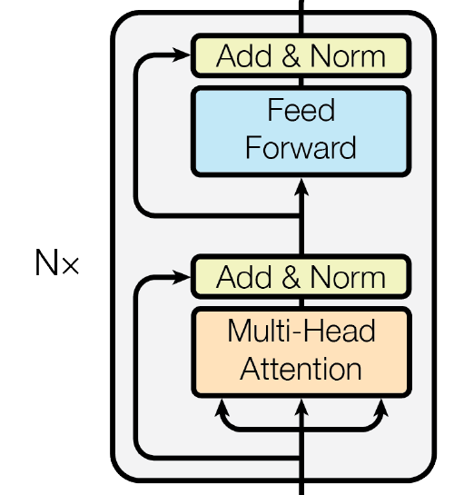
Transformer
Transformer Encoder Transformer Decoder

Slide 13
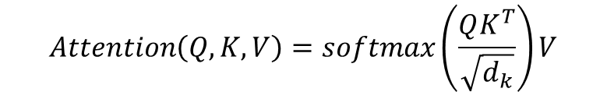
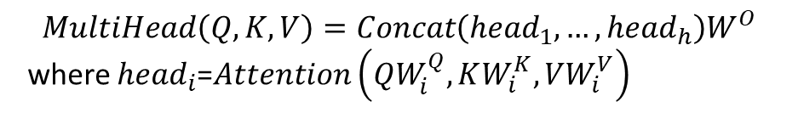
Transformer
$$Attention\left(Q,K,V\right)=softmax\left(\frac{QK^{T}}{\sqrt{d_{k}}}\right)V$$
$$MultiHead\left(Q,K,V\right)=Concat\left({head}_{1}, …,{head}_{h}\right)W^{O}$$
where ${head}_{i}$=$Attention\left(QW_{i}^{Q},KW_{i}^{K},VW_{i}^{V}\right)$

Slide 14
Other Papers
A Simple Neural Attentive Meta-Learner (Mishra et al., 2017)
Self-Attention Generative Adversarial Networks (Zhang at al., 2018)

Slide 15
Thank You

